Slide 1
PJM Footprint Roundtable
Electrifying the Building Sector
Rick Nortz, Senior Manager, Mitsubishi Electric Trane HVAC US
Rnortz@hvac.mea.com
December 18, 2019

Slide 2
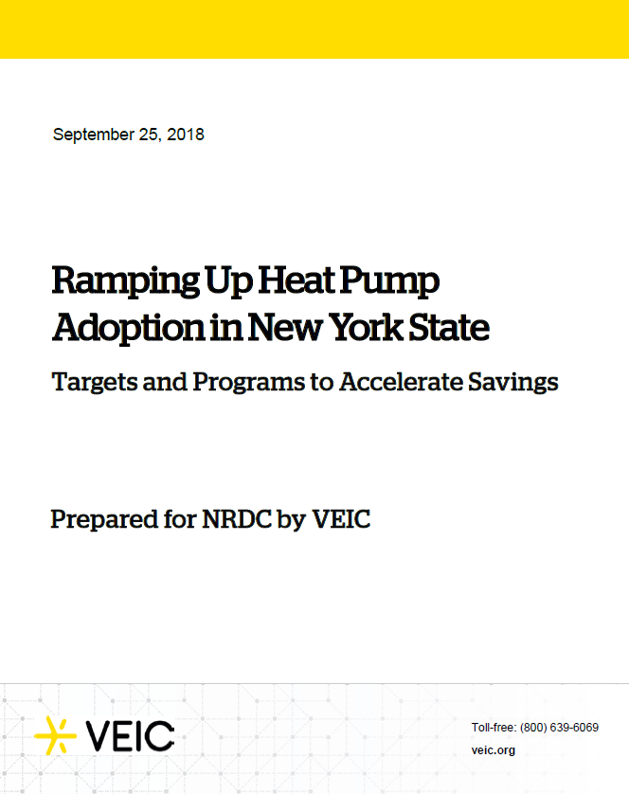
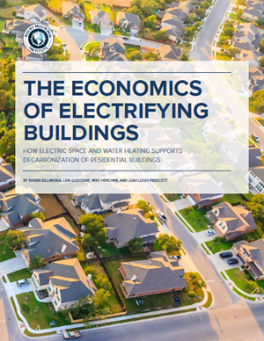
Transportation = EV’s
Building Decarbonzation = HP’s
2
Notes:
Over this past year, nearly every environmental organization, implementer, utility, states, cities have created a report showing that electrification is the pathway to address climate change… EV’s for vehicles, and heat pumps for building decarbonization. They all agree that Heat Pumps are the future of building heating and cooling in the US.
We are at the INTERSECTION of SCIENCE and TECHNOLOGY…. This issue is going to be solved using technology that has only been available to us for a short period…
It is OUR equipment, HEAT PUMPS, that are the present and Future solution to a past problem!!

Slide 3

Extra Extra…Read All About It
Chicago implementing Energy Rating System
August 2019
Chicago commits to 100% renewable energy by 2035
Philadelphia announces Energy Performance Program – Dec 2019
Pittsburgh Mayor introduces legislation for city buildings to be net zero.
Washington DC commits to 100% renewable energy by 2032.
Notes:
Extra Extra – Read All About it.
Philadelphia’s goal: 25% x 2025, 75% of GHG’s come from buildings,
Chicago: Energy Rating System passed in 2017, being implemented in 2020. Creating a baseline for buildings 50,000 sq. feet and greater (3400)

Slide 4

Heat Pumps Are Next
80% x 2050
Building De-Carbonization
100% renewable energy
EV conversion
Gas moratorium
Fuel switching
Net Zero requirements
Alternative Portfolio Standards

Slide 5

Not Part of PJM, but ……
Notes:
It would be amazing if we had a fresh pallete like this, to build amazing energy efficient structures from scratch…
But unfortunately our pallete looks like this… incredibly inefficient buildings, crowding the landscape. It will take a monumental effort to improve the efficiency and reduce the pollution being sent into the atmosphere from cities like New York.
But the best news of all is that Heat Pumps are seen as THE solution on the demand side for buildings. We just need to BE THERE for every new construction building and every building undergoing an HVAC retrofit – a mighty challenge, but an a mighty opportunity indeed….

Slide 6

Not Part of PJM, but ……
Electrification is Real!
Heat Pumps can solve the problem now.
Growth is Inevitable!!
We need to BE THERE
-New Construction
-HVAC Retrofits
A mighty challenge, but a gigantic opportunity!!
100% Electrification by 2050
Notes:
It would be amazing if we had a fresh pallete like this, to build amazing energy efficient structures from scratch…
But unfortunately our pallete looks like this… incredibly inefficient buildings, crowding the landscape. It will take a monumental effort to improve the efficiency and reduce the pollution being sent into the atmosphere from cities like New York.
But the best news of all is that Heat Pumps are seen as THE solution on the demand side for buildings. We just need to BE THERE for every new construction building and every building undergoing an HVAC retrofit – a mighty challenge, but an a mighty opportunity indeed….

Slide 7

Gas Bans Not Just For CA & NY
Brookline, MA
  Fossil fuel ban for new construction and renovation.
  Commercial & residential
  Cooking excemption
First, but not last
  Other cities/towns considering
  Statewide ban possible

Slide 8
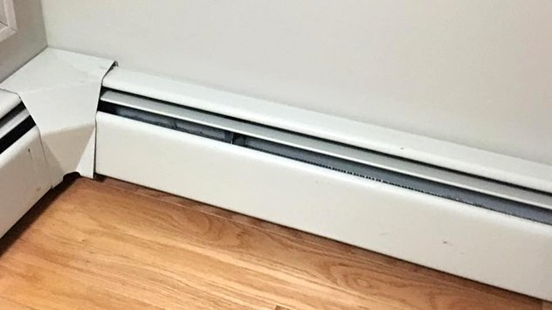


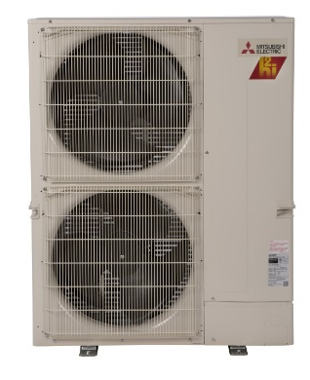

Consumer Awareness/Education
1980’s
Electric Baseboard Heat
1990’s
Delivered Fuels – Oil/Propane
2000’s
Natural Gas
2010’s
Heat Pumps
Not your father’s Heat pump
Notes:
Do you think we have a confused market out there? I mean, we spent the last 40 years confusing the public about what they should heat their homes with. In the 70s it was the Oil embargo and we try to convince people to convert to electric heat. In the 80’s it was a conversion to delivered fuels, and things like propane and oil trucks dotted the neighborhoods. In the 90s we tried to convert people from oil to natural gas. The 2000s now we’re trying to get people off of electric you an offer will end up electricity back in the public not be confused.
The important point is HOW we communicate that the technology has changed, both:
-Yes we are asking you to go back to the future and consider adopting ELECTRIC heating and cooling
– heat pumps are now much more efficient and able to heat to low temperatures – this is not your father’s heat pump…

Slide 9
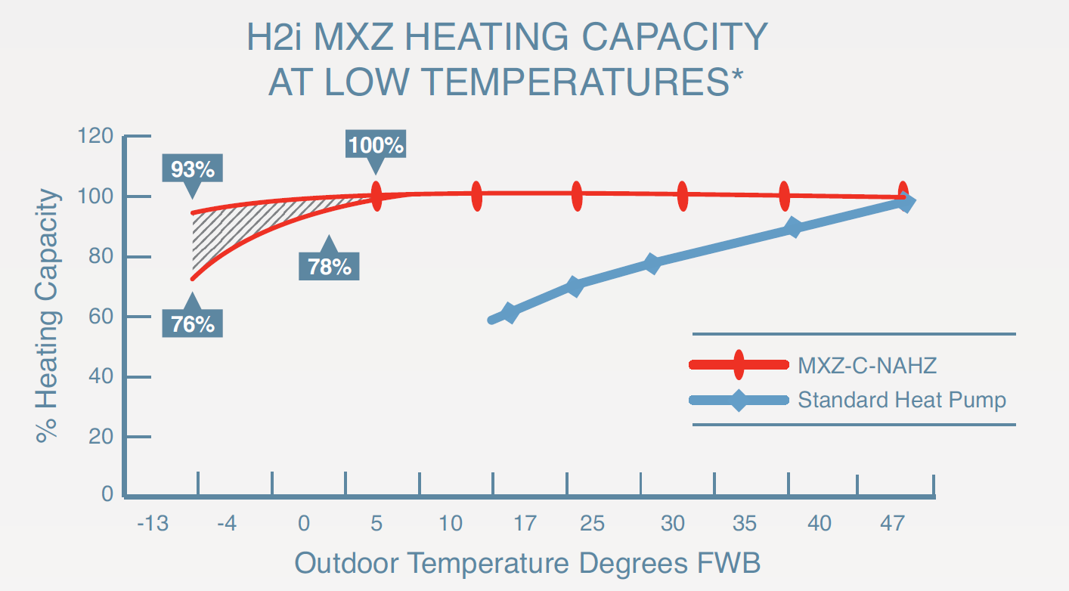
Cold Climate Heat Pumps
Cold Climate Capable
  100% capacity at 5 F.
  ~82% capacity at -13 F.

Slide 10



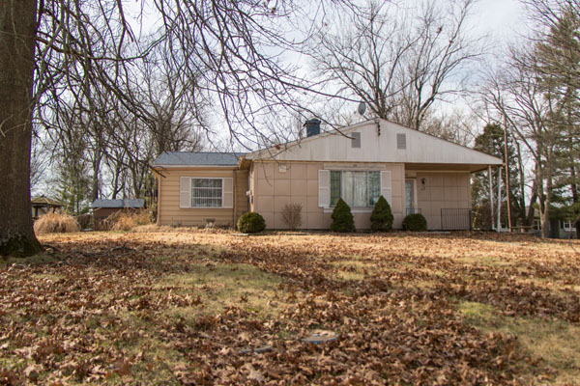
Pilot Collaboration in PJM Footprint
Chicago Income-Qualified Electrically-Heated
80 Units Pilot
100% funded by ComEd
All Mitsubishi Single & Multi-zone
Opportunity: 46,000 Electric Heated Units in Chicago
Target High Electric Users
25-30 Home Insulate/Mini-Split Heat Pumps
Single City
Objective = Prove Cost Effective Program for 2021
Thanks to Brian Porter, Anthony Belokas, Mike Schaefer
Notes:
A final example is a project we just secured with ComEd in Chicago, that is aimed at studying the conversion of income qualified apartments that are electrically heated. The project is 100% fully funded by ComEd for 80 units, and it will be entirely Mitsubishi. The objective of a Pilot such as this is to inform the design of a new program to address the 46,000 electrically heated units in Chicago.

Slide 11
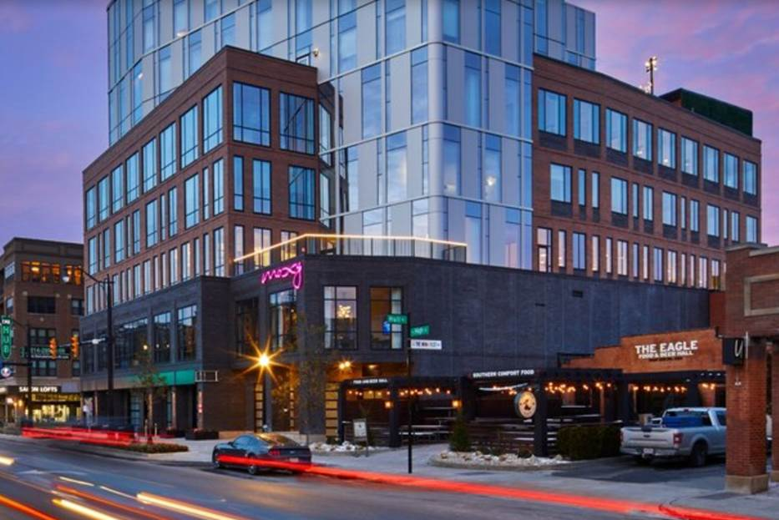

Variable Refrigerant Flow in PJM Footprint
Marriott Moxy
116 rooms
6-9th floors
Air sourced VRF
AC Marriott
104,000 ft²
150 rooms
Water sourced VRF
Thanks to Brian Porter, Anthony Belokas, Mike Schaefer
Notes:
A final example is a project we just secured with ComEd in Chicago, that is aimed at studying the conversion of income qualified apartments that are electrically heated. The project is 100% fully funded by ComEd for 80 units, and it will be entirely Mitsubishi. The objective of a Pilot such as this is to inform the design of a new program to address the 46,000 electrically heated units in Chicago.

Slide 12
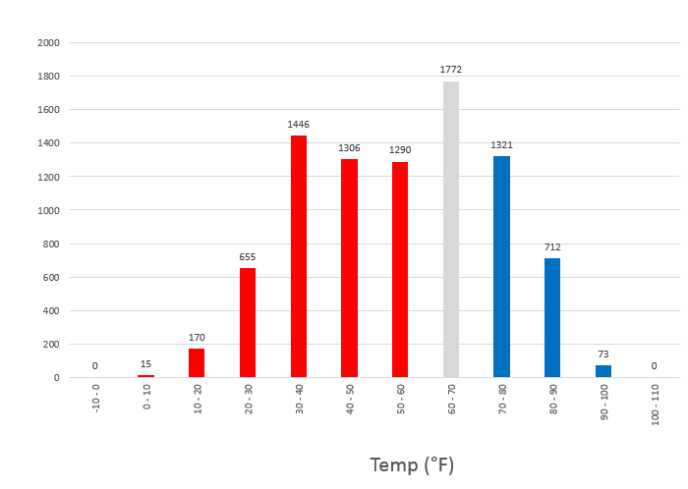
Barriers to Electrification (Customers)
Rebate programs
  Fossil fuel rebates
  Simple is better for contractors and end users.
Education and Awareness
  Consumers
    Technology works
    How to use?
  Architects and Engineers
  Installers

Slide 13

Barriers to Electrification (Policy)
Multiple standards
  By state, utility or sometimes towns.
  Needs to be regional.
Time of Use Rates
  Heat Pump use can’t be moved.
Low and Moderate Income
Landlords
  34% of population rents

Slide 14
Thank You
Rick Nortz
RNortz@hvac.mea.com
617-733-1058

